Slide 1
Discrete Mathematics and Its Application 7th edition, 2001
Kenneth H. Rosen

Slide 2
Welcome to Discrete Mathematics Spring 2018
Instructor: Niu Shao Zhang

Slide 3
§2.4 Sequences, Strings, Summations
Section Summary
Sequences.
Examples: Geometric Progression, Arithmetic Progression(几何级数、算数级数)
Recurrence Relations（递推关系）
Example: Fibonacci Sequence（斐波那契数列）
Summations
Special Integer Sequences

Slide 4
§2.4 Sequences, Strings, Summations
Introduction
Sequences are ordered lists of elements.
1, 2, 3, 5, 8
1, 3, 9, 27, 81, …….
Sequences arise throughout mathematics, computer science, and in many other disciplines(学科), ranging from botany(植物学) to music.
We will introduce the terminology to represent sequences and sums of the terms in the sequences.

Slide 5
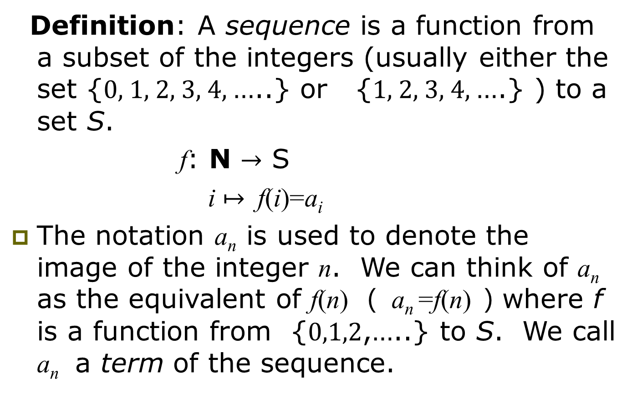
Sequences
Definition: A sequence is a function from a subset of the integers (usually either the set {0, 1, 2, 3, 4, …..} or {1, 2, 3, 4, ….} ) to a set S.
f: N $→$ S
i $↦$ f(i)=a_{i}
The notation a_{n} is used to denote the image of the integer n. We can think of a_{n} as the equivalent of f(n) （ a_{n} =f(n) ）where f is a function from {0,1,2,…..} to S. We call a_{n} a term of the sequence.

Slide 6
Sequence Examples
Some authors write “the sequence a₁, a₂, …” instead of {a_{n}}, to ensure that the set of indices is clear.
Be careful: Our book often leaves the indices ambiguous.
An example of an infinite series:
Consider the series {a_{n}} = a₁, a₂, …, where (∀n≥1) a_{n}= f(n) = 1/n.
Then, we have {a_{n}} = 1, 1/2, 1/3, …

Slide 7
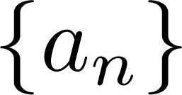
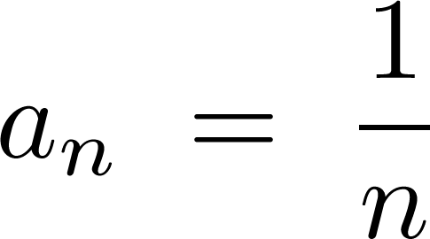
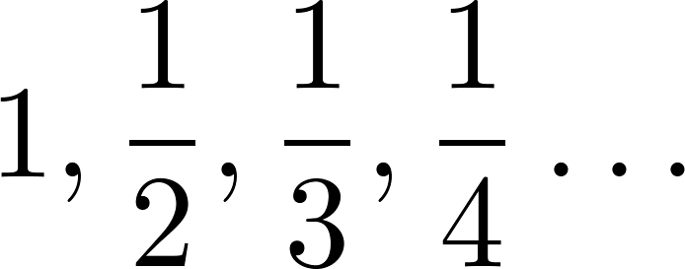
Sequences
Example: Consider the sequence where

Slide 8
Example with Repetitions
Like tuples, but unlike sets, a sequence may contain repeated instances of an element.
Consider the sequence {b_{n}} = b₀, b₁, … (note that 0 is an index) where b_{n} = (−1)^{n}.
Thus, {b_{n}} = 1, −1, 1, −1, …
Note repetitions!
This {b_{n}} denotes an infinite sequence of 1’s and −1’s, not the 2-element set {1, −1}.

Slide 9
Recognizing Sequences
Sometimes, you’re given the first few terms of a sequence,
and you are asked to find the sequence’s generating function,
or a procedure to enumerate the sequence.
Examples: What’s the next number?
1,2,3,4,…
1,3,5,7,9,…
2,3,5,7,11,...
5 (the 5th smallest number >0)
11 (the 6th smallest odd number >0)
13 (the 6th smallest prime number)

Slide 10
Strings
Definition: A string is a finite sequence of characters from a finite set (an alphabet).
Sequences of characters or bits are important in computer science.
The empty string is represented by λ.
The string abcde has length 5.

Slide 11
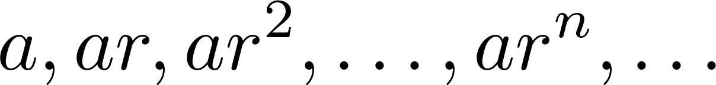
Geometric Progression
Definition: A geometric progression is a sequence of the form:
where the initial term a and the common ratio r are real numbers.
Examples:
Let a = 1 and r = −1. Then:
Let a = 2 and r = 5. Then:
Let a = 6 and r = 1/3. Then:

Slide 12
Arithmetic Progression
Definition: A arithmetic progression is a sequence of the form:
where the initial term a and the common difference d are real numbers.
Examples:
Let a = −1 and d = 4:
Let a = 7 and d = −3:
Let a = 1 and d = 2:

Slide 13
Recurrence Relations（递推关系）
Definition: A recurrence relation for the sequence {a_{n}} is an equation that expresses a_{n} in terms of one or more of the previous terms of the sequence, namely, a₀, a₁, …, a_{n-1}, for all integers n with n ≥ n₀, where n₀ is a nonnegative integer.
A sequence is called a solution of a recurrence relation if its terms satisfy the recurrence relation.
The initial conditions for a sequence specify the terms that precede the first term where the recurrence relation takes effect.

Slide 14
Questions about Recurrence Relations
Example 1: Let {a_{n}} be a sequence that satisfies the recurrence relation a_{n} = a_{n-1} + 3 for n = 1,2,3,4,…. and suppose that a₀ = 2. What are a₁ , a₂ and a₃?
[Here a₀ = 2 is the initial condition.]
Solution: We see from the recurrence relation that
a₁ = a₀ + 3 = 2 + 3 = 5
a₂ = 5 + 3 = 8
a₃ = 8 + 3 = 11

Slide 15
Questions about Recurrence Relations
Example 2: Let {a_{n}} be a sequence that satisfies the recurrence relation a_{n} = a_{n-1} – a_{n-2} for n = 2,3,4,…. and suppose that a₀ = 3 and a₁ = 5. What are a₂ and a₃?
[Here the initial conditions are a₀ = 3 and a₁ = 5. ]
Solution: We see from the recurrence relation that
a₂ = a₁ - a₀ = 5 – 3 = 2
a₃ = a₂ – a₁ = 2 – 5 = –3

Slide 16
Fibonacci sequence
The Fibonacci sequence, f₀, f₁, f₂, . . . , is defined by the initial conditions f₀ = 0, f₁ = 1,and the recurrence relation f_{n} = f_{n−1} + f_{n−2} for n = 2, 3, 4, . . . .
EXAMPLE 7
Find the Fibonacci numbers f₂, f₃, f₄, f₅, and f₆.

Slide 17
Fibonacci Sequence
Example: Find f₂ ,f₃ ,f₄ , f₅ and f₆ .
Answer:
f₂ = f₁ + f₀ = 1 + 0 = 1,
f₃ = f₂ + f₁ = 1 + 1 = 2,
f₄ = f₃ + f₂ = 2 + 1 = 3,
f₅ = f₄ + f₃ = 3 + 2 = 5,
f₆ = f₅ + f₄ = 5 + 3 = 8.

Slide 18
Factorial sequence
Example 8
Suppose that {a_{n}} is the sequence of integers defined by a_{n} = n!, the value of the factorial function at the integer n, where n = 1, 2, 3, . . .. Because n! = n((n − 1)(n − 2) . . . 2 ・ 1) =n(n − 1)! = na_{n−1}, we see that the sequence of factorials satisfies the recurrence relation a_{n} = na_{n−1}, together with the initial condition a₁ = 1.

Slide 19
Solving Recurrence Relations
Finding a formula for the nth term of the sequence generated by a recurrence relation is called solving the recurrence relation.
Such a formula is called a closed formula.
Various methods for solving recurrence relations will be covered in Chapter 8 where recurrence relations will be studied in greater depth.
Here we illustrate by example the method of iteration in which we need to guess the formula. The guess can be proved correct by the method of induction (Chapter 5).

Slide 20
Explicit formula
We say that we have solved the recurrence relation together with the initial conditions when we find an explicit formula, called a closed formula, for the terms of the sequence.

Slide 21
Iterative(迭代) Solution Example
Method 1: Working upward, forward substitution
Let {a_{n}} be a sequence that satisfies the recurrence relation a_{n} = a_{n-1} + 3 for n = 2,3,4,…. and suppose that a₁ = 2.
a₂ = 2 + 3
a₃ = (2 + 3) + 3 = 2 + 3 ∙ 2
a₄ = (2 + 2 ∙ 3) + 3 = 2 + 3 ∙ 3
.
.
.
a_{n} = a_{n-1} + 3 = (2 + 3 ∙ (n – 2)) + 3 = 2 + 3(n – 1)

Slide 22
Iterative Solution Example
Method 2: Working downward, backward substitution
Let {a_{n}} be a sequence that satisfies the recurrence relation a_{n} = a_{n-1} + 3 for n = 2,3,4,…. and suppose that a₁ = 2.
a_{n} = a_{n-1} + 3
= (a_{n-2} + 3) + 3 = a_{n-2} + 3 ∙ 2
= (a_{n-3} + 3 )+ 3 ∙ 2 = a_{n-3} + 3 ∙ 3
.
.
.
= a₂ +3(n – 2) = (a₁ +3)+3(n–2) = 2+3(n – 1)

Slide 23
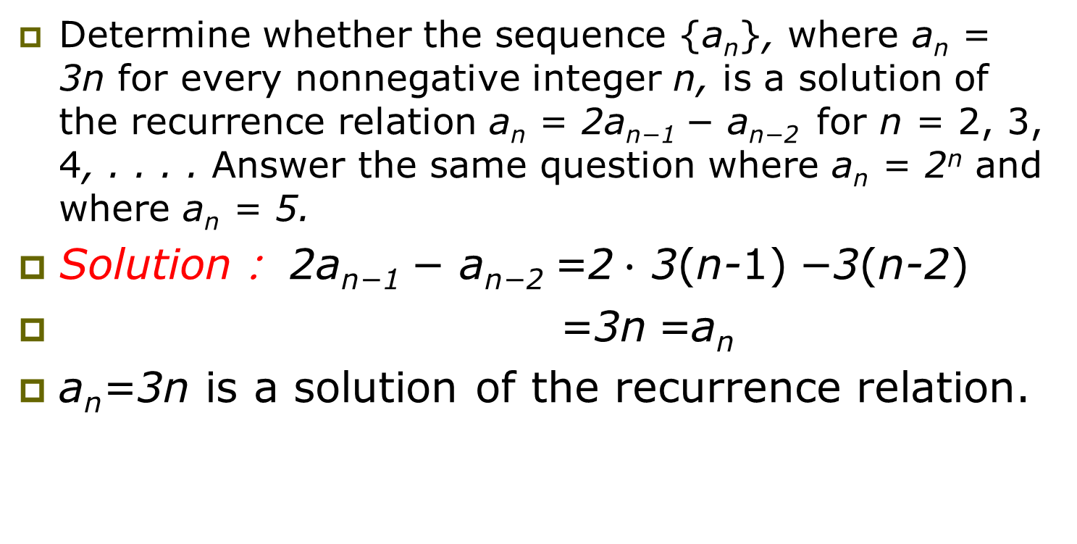
EXAMPLE 9
Determine whether the sequence {a_{n}}, where a_{n} = 3n for every nonnegative integer n, is a solution of the recurrence relation a_{n} = 2a_{n−1} − a_{n−2} for n = 2, 3, 4, . . . . Answer the same question where a_{n} = 2^{n} and where a_{n} = 5.
Solution： 2a_{n−1} − a_{n−2} =2$∙$ 3(n-1) −3(n-2)
=3n =a_{n}
a_{n}=3n is a solution of the recurrence relation.

Slide 24
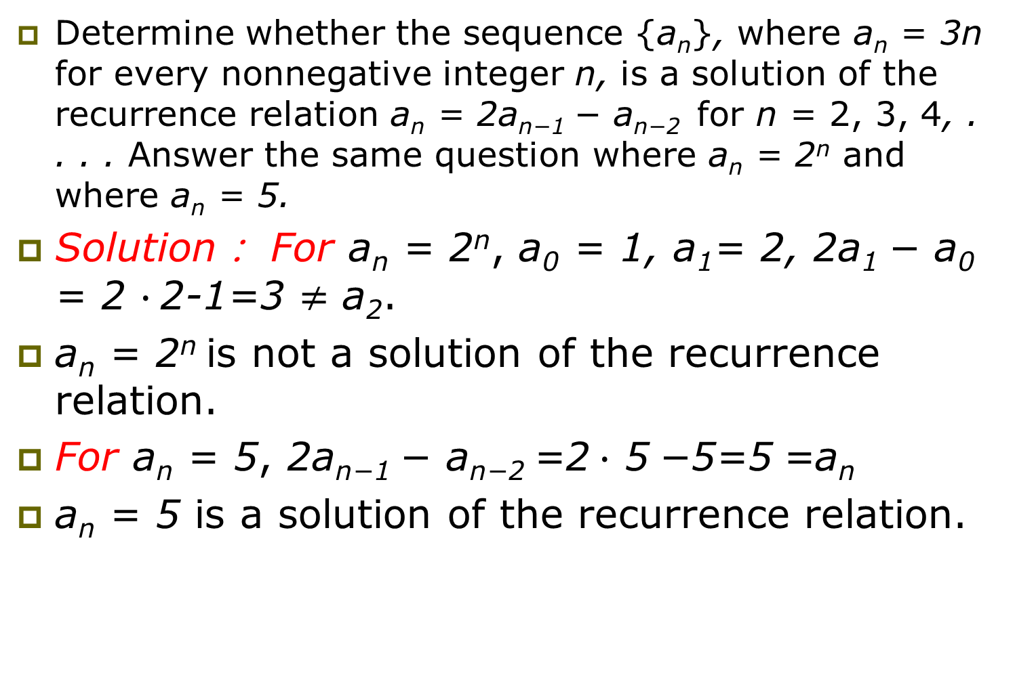
Determine whether the sequence {a_{n}}, where a_{n} = 3n for every nonnegative integer n, is a solution of the recurrence relation a_{n} = 2a_{n−1} − a_{n−2} for n = 2, 3, 4, . . . . Answer the same question where a_{n} = 2^{n} and where a_{n} = 5.
Solution： For a_{n} = 2^{n}, a₀ = 1, a₁= 2, 2a₁ − a₀ = 2 $∙$2-1=3 $≠$ a₂.
a_{n} = 2^{n} is not a solution of the recurrence relation.
For a_{n} = 5, 2a_{n−1} − a_{n−2} =2$∙$ 5 −5=5 =a_{n}
a_{n} = 5 is a solution of the recurrence relation.

Slide 25
Financial Application
P_{n} = P_{n-1} + 0.11P_{n-1} = (1.11) P_{n-1}
with the initial condition P₀ = 10,000
Solution: Forward Substitution
P₁ = (1.11)P₀
P₂ = (1.11)P₁ = (1.11)²P₀
P₃ = (1.11)P₂ = (1.11)³P₀
:
P_{n} = (1.11)P_{n-1} = (1.11)^{n}P₀ = (1.11)^{n} 10,000
P_{n} = (1.11)^{n} 10,000 (Can prove by induction, covered in Chapter 5)
P₃₀ = (1.11)³⁰ 10,000 = $228,992.97

Slide 26
Special Integer Sequences
Given a few terms of a sequence, try to identify the sequence. Conjecture a formula, recurrence relation, or some other rule.
Some questions to ask?
Are there repeated terms of the same value?
Can you obtain a term from the previous term by adding an amount or multiplying by an amount?
Can you obtain a term by combining the previous terms in some way?
Are they cycles among the terms?
Do the terms match those of a well known sequence?

Slide 27
Questions on Special Integer Sequences
Example 1: Find formulae for the sequences with the following first five terms: 1, ½, ¼, 1/8, 1/16
Solution: Note that the denominators are powers of 2. The sequence with a_{n} = 1/2^{n} is a possible match. This is a geometric progression with a = 1 and r = ½.

Slide 28
Questions on Special Integer Sequences
Example 2: Consider 1,3,5,7,9
Solution: Note that each term is obtained by adding 2 to the previous term. A possible formula is a_{n} = 2n + 1. This is an arithmetic progression with a =1 and d = 2.

Slide 29
Questions on Special Integer Sequences
Example 3: 1, -1, 1, -1,1
Solution: The terms alternate between 1 and -1. A possible sequence is a_{n} = (−1)^{n} . This is a geometric progression with a = 1 and r = −1.

Slide 30
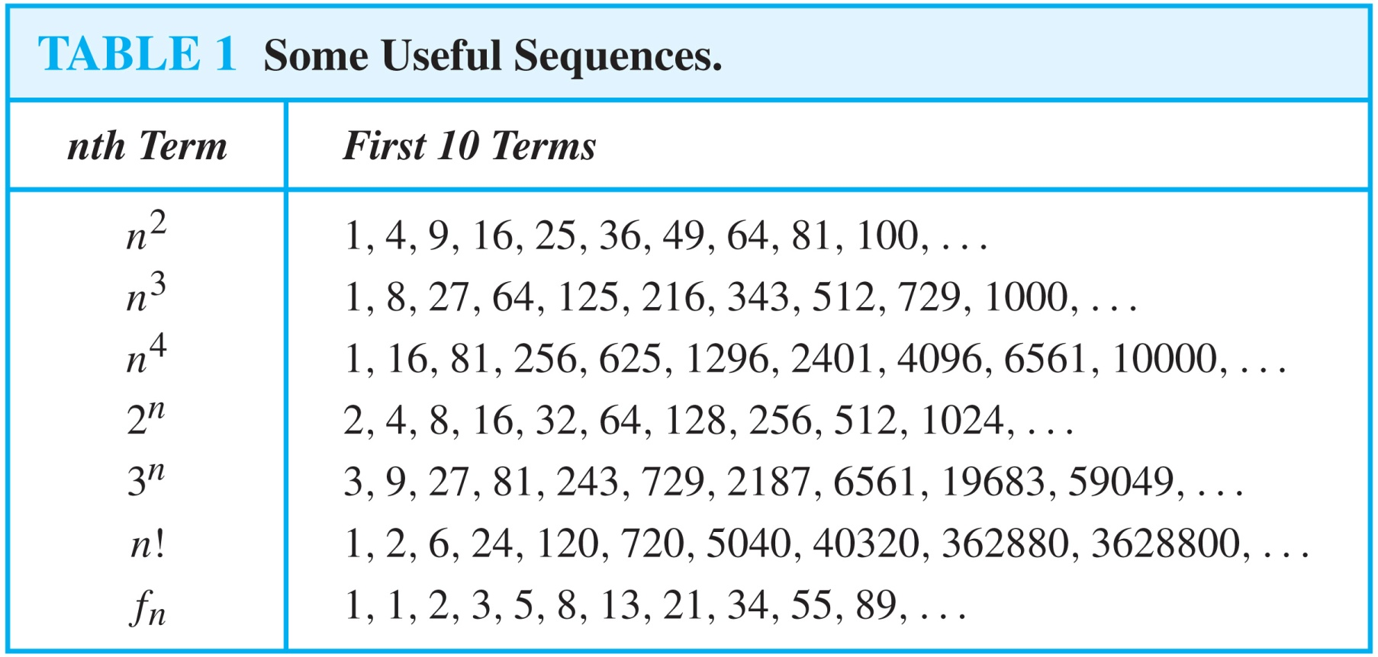
Useful Sequences

Slide 31
Guessing Sequences (optional)
Example: Conjecture a simple formula for a_{n} if the first 10 terms of the sequence {a_{n}} are 1, 7, 25, 79, 241, 727, 2185, 6559, 19681, 59047.
Solution: Note the ratio of each term to the previous approximates 3. So now compare with the sequence 3^{n} . We notice that the nth term is 2 less than the corresponding power of 3. So a good conjecture is that a_{n} = 3^{n} − 2.

Slide 32
Special integer sequences
Example 14 How can we produce the terms of a sequence if the first 10 terms are 5, 11, 17, 23, 29, 35, 41, 47, 53, 59?
Solution: Note that a_{n}=a_{n-1} + 6 (n>1) that is, a reasonable guess is that the nth term is
5 + 6(n -1) = 6n -1
(This is an arithmetic progression with a = 5 and d = 6.)

Slide 33
Special integer sequences
Example 15 How can we produce the terms of a sequence if the first 10 terms are 1, 3, 4, 7, 11, 18, 29, 47, 76, 123?
Solution:
Starting with the third term, is the sum of the two previous terms. That is, 4 = 3 + 1， 7 = 4 + 3, 11= 7 + 4, and so on.
Consequently, if L_{n} is the nth term of this sequence, by the recurrence relation L_{n}= L_{n -1}+L_{n-2} with initial conditions L₁ =1, L₂ =3.
This sequence is known as the Lucas sequence (卢卡斯数列, the same recurrence relation as the Fibonacci sequence, but with different initial conditions).

Slide 34
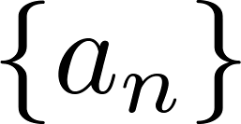
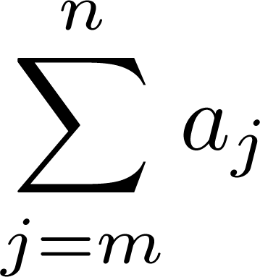
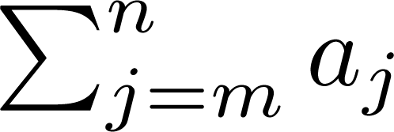
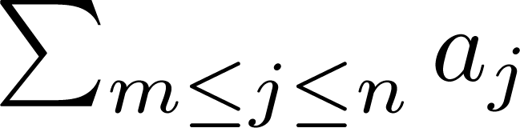
Summation Notation
Sum of the terms
from the sequence
The notation:
represents
The variable j is called the index of summation. It runs through all the integers starting with its lower limit m and ending with its upper limit n.

Slide 35
Generalized Summations
For an infinite series, we may write:
To sum a function over all members of a set X={x₁, x₂, …}:
Or, if X={x|P(x)}, we may just write:

Slide 36
Simple Summation Example

Slide 37
More Summation Examples
An infinite series with a finite sum:
Using a predicate to define a set of elements to sum over:

Slide 38
Summation Manipulations
Some handy identities for summations:
(Distributive law.)
(An application of commut- ativity.)
(Index shifting.)

Slide 39
More Summation Manipulations
Other identities that are sometimes useful:
(Series splitting.)
(Order reversal.)
(Grouping.)

Slide 40
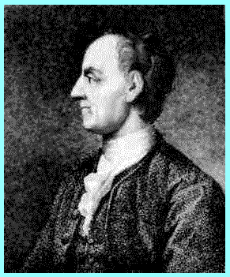
Example: Impress Your Friends
Boast, “I’m so smart; give me any 2-digit number n, and I’ll add all the numbers from 1 to n in my head in just a few seconds.”
I.e., Evaluate the summation:
There is a simple closed-form formula for the result, discovered by Euler at age 12!
And frequently rediscovered by many…
Leonhard Euler (1707-1783)

Slide 41
Euler’s Trick, Illustrated
Consider the sum: 1+2+…+(n/2)+((n/2)+1)+…+(n-1)+n
We have n/2 pairs of elements, each pair summing to n+1, for a total of (n/2)(n+1).
n+1
…
n+1
n+1

Slide 42
Symbolic Derivation of Trick
For case where n is even…

Slide 43
Concluding Euler’s Derivation
So, you only have to do 1 easy multiplication in your head, then cut in half.
Also works for odd n (prove this at home).

Slide 44
Example: Geometric Progression
A geometric progression is a series of the form a, ar, ar², ar³, …, ar^{k}, where a,r∈R.
The sum of such a series is given by:
We can reduce this to closed form via clever manipulation of summations...

Slide 45
Geometric Sum Derivation
Here we go...

Slide 46
Derivation example cont...

Slide 47
Concluding long derivation...

Slide 48
Nested Summations
These have the meaning you’d expect.
Note issues of free vs. bound variables, just like in quantified expressions, integrals, etc.

Slide 49
Some Shortcut Expressions
Geometric series.
Euler’s trick.
Quadratic series.
Cubic series.

Slide 50
Using the Shortcuts
Example: Evaluate .
Use series splitting.
Solve for desired summation.
Apply quadratic series rule.
Evaluate.

Slide 51
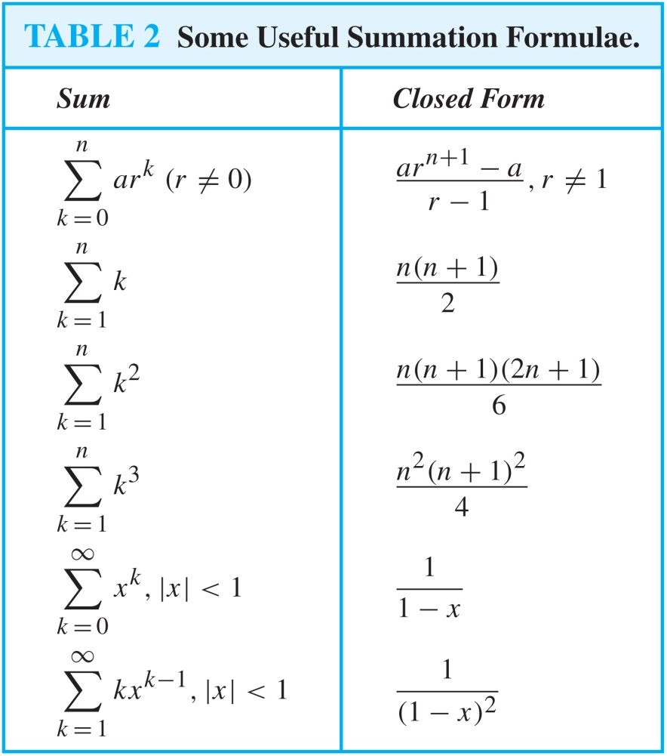
Some Useful Summation Formulae
Geometric Series: We just proved this.
Later we will prove some of these by induction.
Proof in text
(requires calculus)

Slide 52
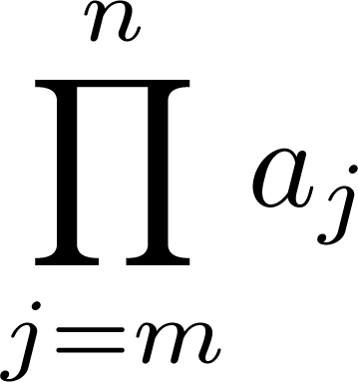
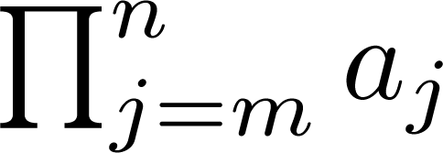
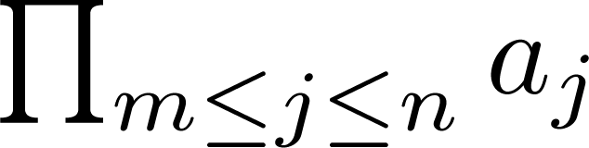
Product Notation
Product of the terms
from the sequence
The notation:
represents

Slide 53
Homework
§2.4
6(a,c,e,g), 12(a,d), 18,
26(a,f), 30(b,d), 34(b)

